Slide 1

WT
resistant
lysogen
Phages
infection death
induction
offspring WT
New Phages
offspring r
offspring l
New Phages
fitness cost
mutation
integration
Population t
Phages
New WT
New r
New l
Population t+1
Notes:
two strategies: resistance and lysogen. one is phage-dependent and one is phage-independent

Slide 2
Questions
how do the two strategies perform under different conditions?
when does extinction occur?

Slide 3
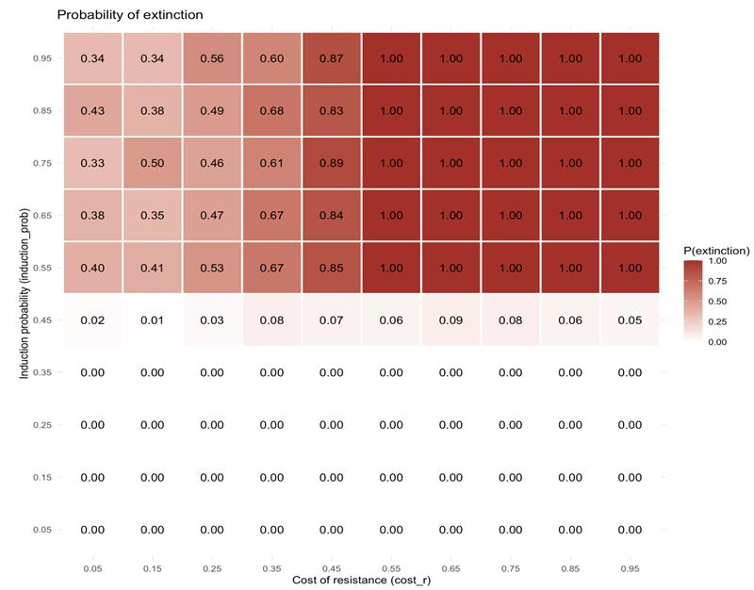

Slide 4
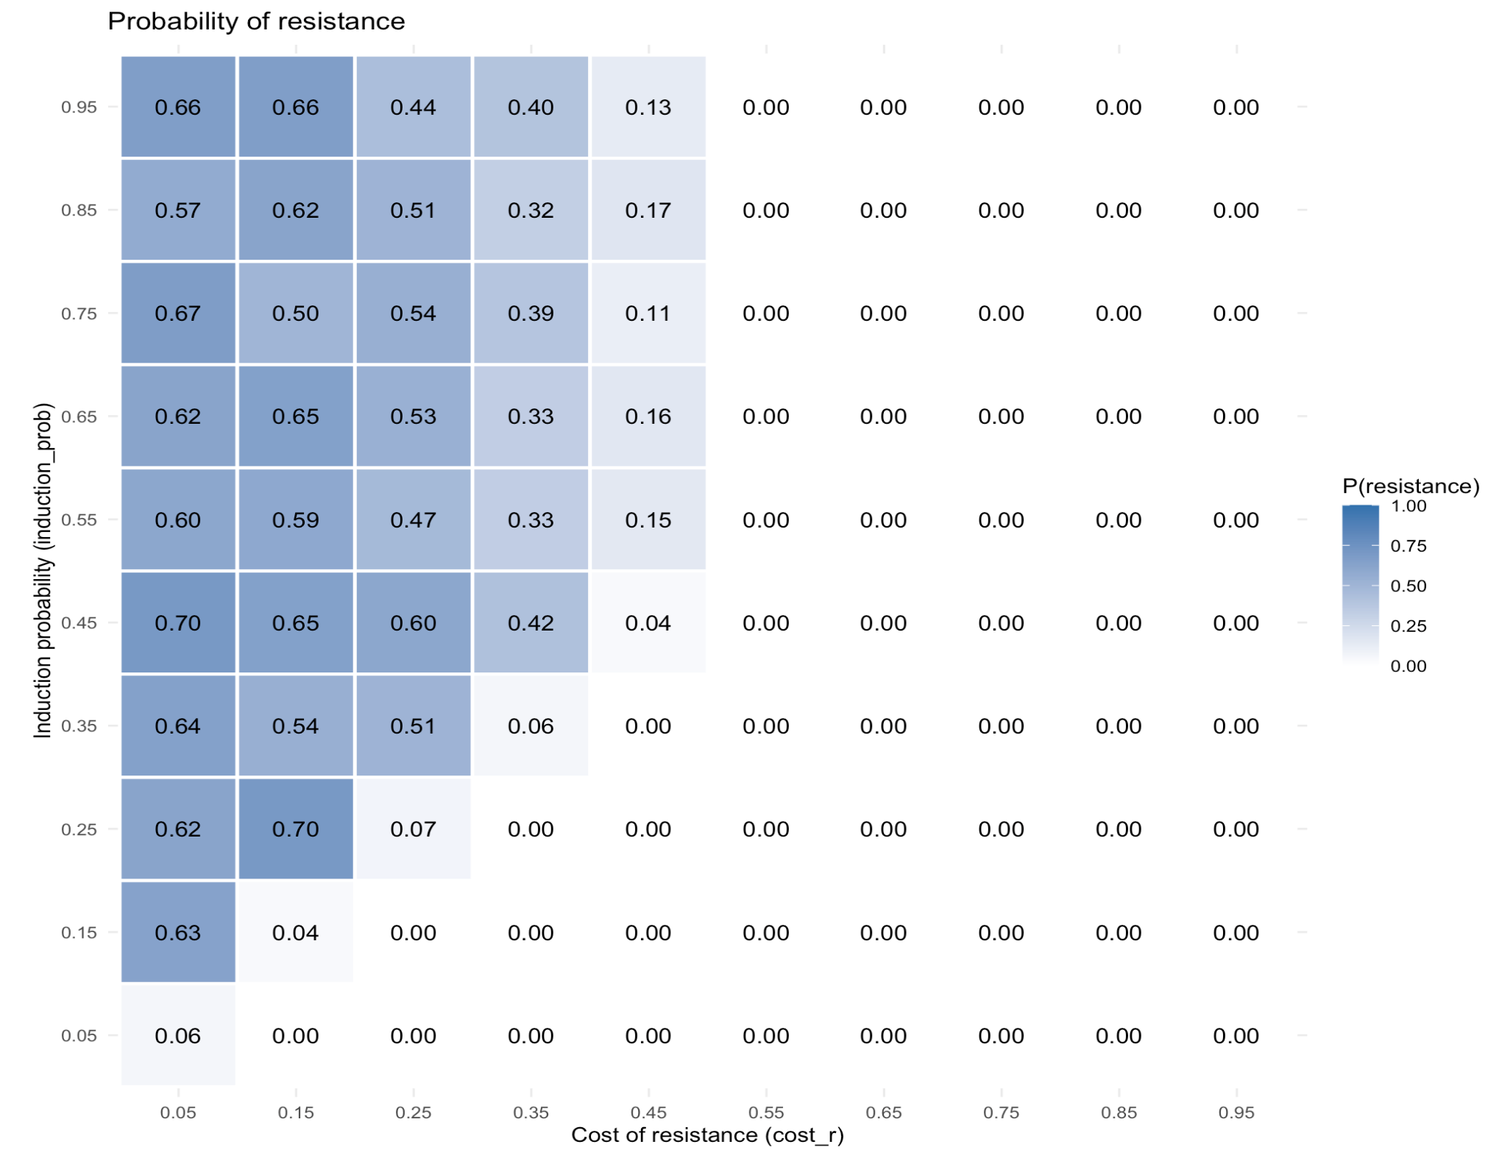
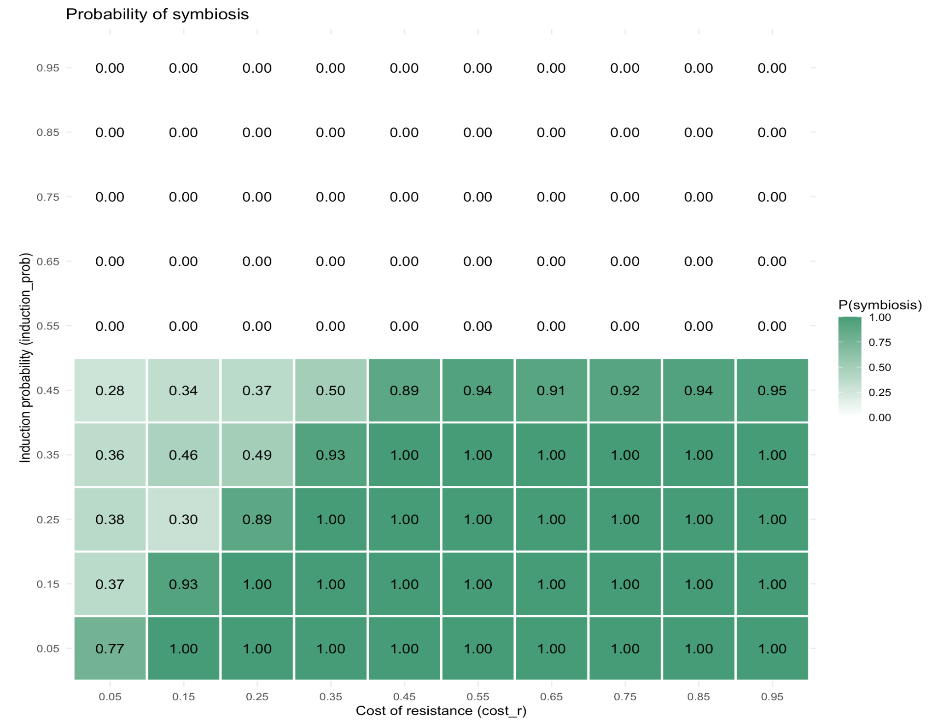
p(r) is gradual, p(s) is abrupt
Notes:
conclusions: for experiments --> symbiotic resistance is much easier to test
resistance: one mutation, have to wait for it
symbiosis: boost mutation. neutralize stochastic mutation rate --> becomes deterministic. fitness rate is not high enough to maintain pop above 0.5 so there's barupt drop in probability

Slide 5


